Slide 1


CS 6831 Designing Secure Cryptography
Tom Ristenpart

Slide 2
Two-step MD design paradigm for hash functions
Compression
Function
Hash Function
d
*
n
Domain
extension
transform
n
f
n
H
Example: domain extension using “Merkle-Damgard with strengthening”
M1
M2
M3||10^{r} || <|M|>
Used in
MD-x, SHA-1,
SHA-256, …
f
f
f
IV
H(M)
r is minimal number of zeros needed to get to multiple of block size
IV is a fixed constant. Not randomly chosen.

Slide 3
SHA-3 competition
SHA-1 attacks prompted NIST competition for new hash function 2007-2012
51 submissions; 14 proceeded to round 2; 5 finalists
KECCAK selected as winner
Bertoni, Daemon, Peeters, Van Assche

Slide 4
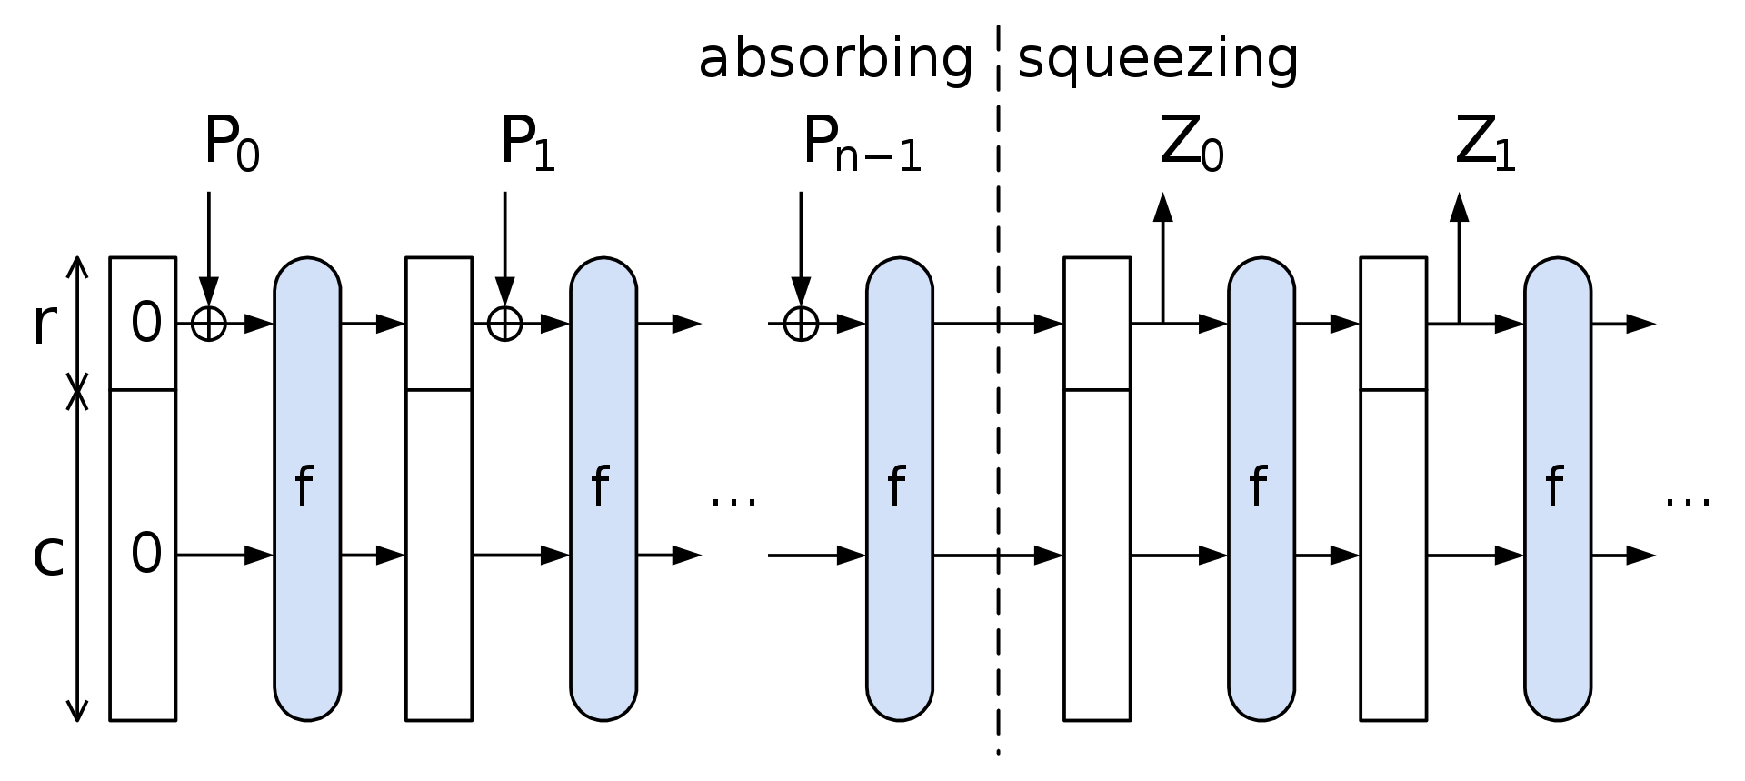
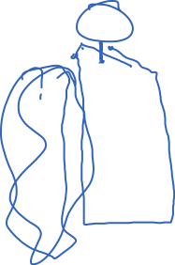

Sponge construction
f : {0,1}^{r+c} -> {0,1}^{r+c} is a permutation
https://en.wikipedia.org/wiki/SHA-3
c referred to as capacity, should be at least twice desired security in bits
r referred to as rate
Example: SHA3-256 has c = 512, r = 1088, output length of 256

Slide 5
Other security goals for hash functions
Preimage resistance / one-wayness
Second preimage resistance
PRF when keyed appropriately
Random oracle

Slide 6
Preimage resistance & second preimage resistance
Adversary shouldn’t be able to find preimages of range points
Lots of options for defining this:
Some set of fixed range points?
Random range point?
Hash of random domain point?
Can’t find message that collides with some chosen message
Many variants exist, see [Rogaway-Shrimpton 2004]
(https://eprint.iacr.org/2004/035.pdf)

Slide 7
Preimage resistance & second preimage resistance
Best generic attacks?
Run in time 2^{n} (n is output size)
for both goals
Many variants exist, see [Rogaway-Shrimpton 2004]
(https://eprint.iacr.org/2004/035.pdf)

Slide 8
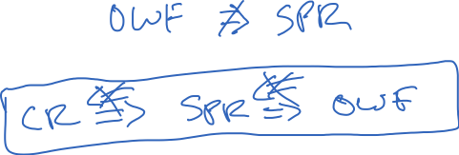
CR, OWF, and SPR comparisons
Consider
(assume message space sufficiently larger than range)
Notes:
CR => SPR => OWF

Slide 9


OWF-type application: password hashing
Password hashing. Choose random salt and store (salt,h) where:
Is this secure based on OWF security of H?
salt || pw
H
h
The idea: Attacker, given (salt,h), should not be able to recover pw
What is brute-force attack?
Let p be some probability distribution over message space
For each guess pw’:
If H(salt||pw’) = h then
Ret pw’

Slide 10

The random oracle model (ROM)
Model hash functions as public random functions
Instantiate with suitable cryptographic hash functions later
All algorithms obtain oracle access to it
Analogous to ideal cipher model, but for hash functions
[Bellare, Rogaway 1993]

Slide 11

Password hashing in ROM
Define min-entropy of p as
Probability of guessing pw in one guess is at most

Slide 12
Other security goals for hash functions
Preimage resistance / one-wayness
Second preimage resistance
PRF when keyed appropriately
Random oracle

Slide 13
Hash-based PRF in ROM
Consider building a PRF
Using a simple hash-based construction:
K || M
H
Y
For ROM analysis, F must use an oracle:

Slide 14
Hash-based PRF in ROM
K || M
H
Y
Security argument:
Only way to distinguish is to query H on K || M for some M
Given q queries to H, probability of doing so at most q / 2^{k} if key K is k bits long
PRF advantage of any adversary A making q queries upper-bounded by q / 2^{k}

Slide 15
Hash-based PRF in ROM

Slide 16
What does ROM security mean?
Random oracles don’t really exist; they are an idealized model
We must “instantiate” random oracle with good hash function
Hope: If hash function is designed well security will still hold
Mathematically instantiation crosses between security models, and security results don’t necessarily carry over. Thus ROM analyses are often called heuristic analyses
Canetti, Goldreich, Halevi 1998 showed an uninstantiability result
Scheme secure in ROM that is insecure for any real hash function
Quite artificial example (scheme does strange things)
We are more interested in whether security holds for hash functions used in practice

Slide 17
Instantiate Hash-based PRF with SHA-256
K
M1
M2||10^{r} || <|M|>
K || M
H
Y
f
f
f
IV
Y
All MD-based hashes vulnerable to length-extension attacks!

Slide 18




Client authentication on web
[Solo, Kent] [Tsudik – ’92]
PW
PW
msg, H^{f}( PW ∥ msg )
User sent
msg
User
msg ∥ L ∥ X,
H^{f}( PW ∥ msg ∥ L ∥ X )
User sent
msg ∥ L ∥ X
RFC 2069 (HTTP Digest Authentication)
PW
msg
L = 2d
f
f
f
IV
H^{f}(PW ∥ msg)
= h
Extension
attack
X
4d
f
f
h
H^{f}(PW ∥ msg ∥ L ∥ X)

Slide 19

Indifferentiability for hash transform design
M1
M2
M3||10^{r} || <|M|>
$$≈$$
RO
f
f
f
IV
Y
Want framework to build hash functions that “behave like” random oracles
[Coron et al. 2005] suggest using indifferentiability framework of
[Maurer, Renner, Holenstein 04] applied to hash functions,
Modeling f as itself a “small” fixed-input-length random oracle

Slide 20



[CDMP05]: what property of a hash function H^{f} suffices
to avoid such structure-abusing attacks?
Indifferentiability from a RO
H^{f}
Real
H
f
RO
Sim
Ideal
D
D
0/1
0/1

Slide 21







[CDMP05]: what property of a hash function H^{f} suffices
to avoid such structure-abusing attacks?
Indifferentiability from a RO

Slide 22
The “magic” is in [MRH04] composition theorem
For any security game G, construction H^{f}, and scheme C, if
(1) H^{f} indifferentiable from RO (f = RO) , and
(2) C provably G-secure in ROM
then C provably G-secure using H^{f} (f = RO)
B
H^{f}
RO
Sim
H
f
RO
D
C
A
C
A
C
B
G
G
G
0/1
0/1
0/1

Slide 23
Indifferentiability
from a RO
≈
“as secure
as a RO”
Indifferentiability has become a core requirement
for hash function design
Seems to rule out all structural attacks
Dozens of indifferentiable hash constructions in literature
SHA-3 hash contestants targeted it
Need to carefully interpret composition theorem (doesn’t apply to all security games)
see [Ristenpart, Shacham, Shrimpton 2011]

Slide 24
MD is not indifferentiable from a RO. What is?
M1
M2
M3||10^{r} || <|M|>
drops s < n bits
f
f
f
IV
C
Chopped Merkle-Damgard
M1
M2
M3||10^{r} || <|M|>
f
f
f
Enveloped Merkle-Damgard
IV1
f
IV2

Slide 25
MD is not indifferentiable from a RO. What is?

Slide 26
Ideal cipher model and ROM equivalency
[CDMP05] showed how one can build indifferentiable from RO construction using an ideal cipher. MD-like transforms above combined with Davies-Meyer compression function
Longstanding open question was inverse: how to build something indifferentiable from ideal cipher from a RO
[Holenstein, Kunzler, Tessaro 2011] showed it
Feistel-like construction, but concrete security is poor
We often use ROM or ICM analyses. Used carefully, they provide great way of showing practical schemes secure

Slide 28
Applications of cryptographic hashing
File comparison
Digital signatures (coming up later)
For message authentication codes
Key derivation
Password hashing

Slide 29
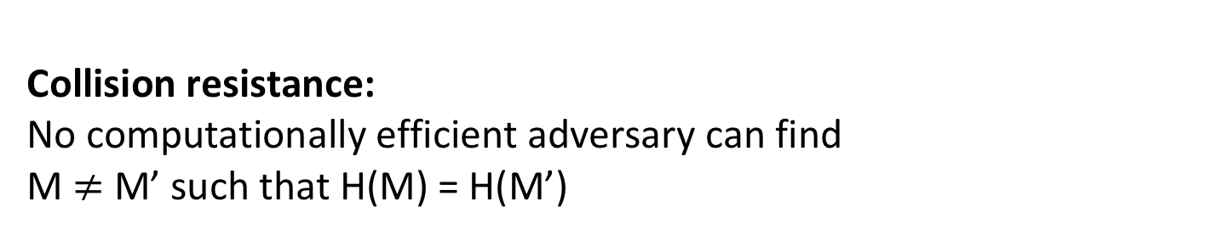
Cryptographic hash functions
MD5: n = 128 bits
SHA-1: n = 160 bits
SHA-256: n = 256 bits
SHA-512: n = 512 bits
SHA-3: n = 224, 256, 384, 512 bits
M
H
H(M)
Collision resistance:
No computationally efficient adversary can find
M $≠$ M’ such that H(M) = H(M’)

Slide 30
Collisions always exist
Domain (usually all strings up to some length)
SHA-256: up to length 2⁶⁴-1
Range {0,1}^{n}
H(M)
M
There exists CR adversary that wins with probability 1 and is efficient
H(M’)
M’
“Human ignorance”:
We can’t figure out what such an adversary is.
Good enough as an assumption
See [Rogaway 06]
M’’
H(M’’)
Not drawn to scale!!!
Pigeonhole principle:
size of domain larger than size of range implies there must be collisions

Slide 31
Birthday attacks
What is best possible security achievable by hash function with output length n bits?
Answer: security is only achievable up to 2^{n/2} hash computations

Slide 32
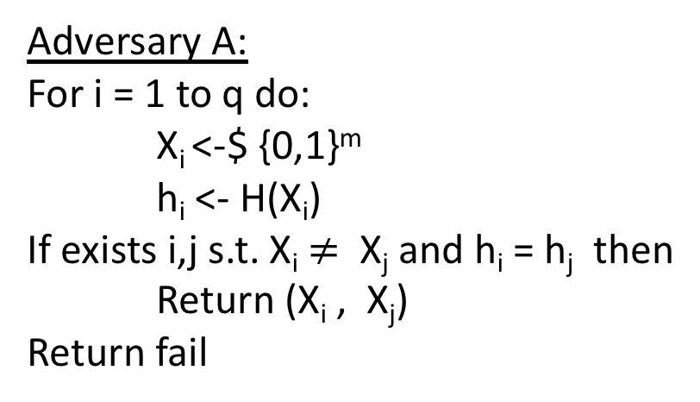
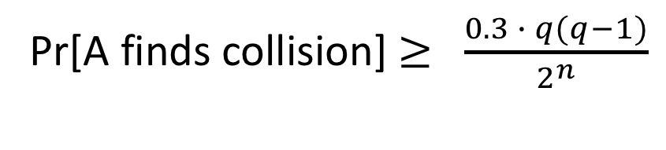
The birthday attack
Let m be some length in domain of hash function H
Adversary A:
For i = 1 to q do:
X_{i} <-$ {0,1}^{m}
h_{i} <- H(X_{i})
If exists i,j s.t. X_{i} $≠$ X_{j} and h_{i} = h_{j} then
Return (X_{i} , X_{j})
Return fail
Same # of domain points
map to each range point
If H is regular then probability of success is exactly birthday probability
Pr[A finds collision] $≥$ $\frac{0.3 ∙ q(q−1)}{2^{n}}$

Slide 33

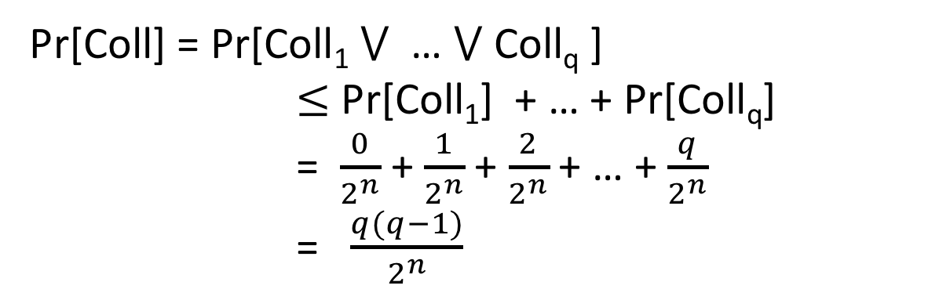
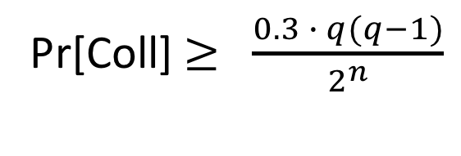
The birthday problem
Choose q values Y₁,…,Y_{q} from {0,1}^{n} at random. What is probability that two are the same?
Let Coll_{i} be event that Y_{i} = Y_{j} for some j < i
Pr[Coll] = Pr[Coll₁ $⋁$ … $⋁$ Coll_{q} ]
$≤$ Pr[Coll₁] + … + Pr[Coll_{q}]
= $\frac{0}{2^{n}}$ + $\frac{1}{2^{n}}$ + $\frac{2}{2^{n}}$ + … + $\frac{q}{2^{n}}$
= $\frac{q(q−1)}{2^{n}}$
Another proof shows that if q $≤$ 2^{(n+1)/2}
Pr[Coll] $≥$ $\frac{0.3 ∙ q(q−1)}{2^{n}}$

Slide 34
Birthday attack run times
MD5: n = 128 bits
SHA-1: n = 160 bits
SHA-256: n = 256 bits
2⁶⁴ MD5 computations
2⁸⁰ SHA-1 computations
2¹²⁸ SHA-2 computations
2⁶⁴ too small by today’s standards!
Bitcoin network computes about 2⁶⁵ SHA-256 hashes per second
https://blockchain.info/charts/hash-rate

Slide 35
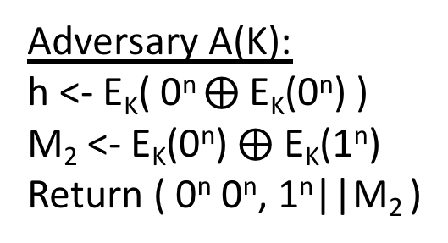
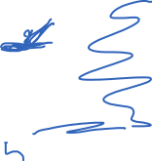
CBC-MAC is not CR
M₁
M₂
M₃
Key was secret in CBC-MAC.
But hash functions are publicly computable.
One idea is to use a random, public K value known to attacker.
E_{K}
E_{K}
E_{K}
h
How do we efficiently find collisions?
Adversary A(K):
h <- E_{K}( 0^{n} $⨁$E_{K}(0^{n}) )
M₂ <- E_{K}(0^{n}) $⨁$ E_{K}(1^{n})
Return ( 0^{n} 0^{n}, 1^{n}||M₂ )
Universal hashes are also not CR

Slide 36
Two-step MD design paradigm for hash functions
Compression
Function
Hash Function
d
*
n
Domain
extension
transform
n
f
n
H
Example: domain extension using “Merkle-Damgard with strengthening”
M1
M2
M3||10^{r} || <|M|>
Used in
MD-x, SHA-1,
SHA-256, …
f
f
f
IV
H(M)
r is minimal number of zeros needed to get to multiple of block size
IV is a fixed constant. Not randomly chosen.

Slide 37
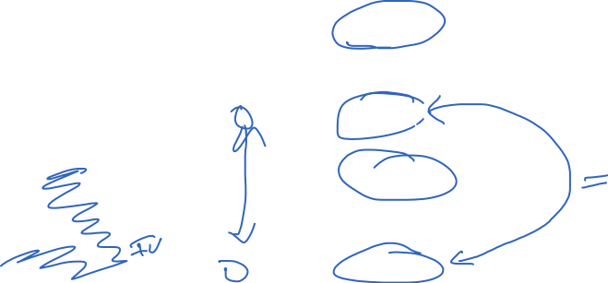
Merkle-Damgard CR preservation result
M1
M2
M3||10^{r} || <|M|>
f
f
f
IV
H(M)
M1’
M2’
M3’||10^{r} || <|M’|>
f
f
f
IV
H(M’)

Slide 38
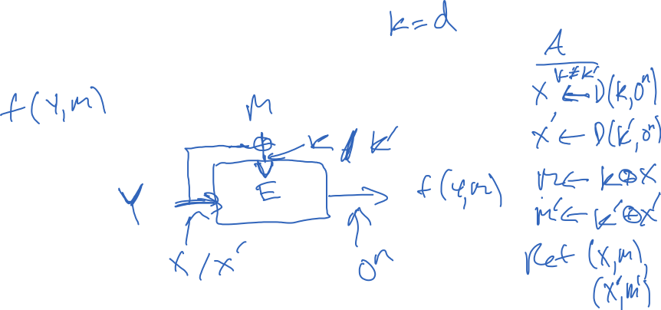
Building compression functions
Want:
Given:
Notes:
Examples of broken uses of block cipher. Simple m + z. E(m,z) or E(z,m).

Slide 39
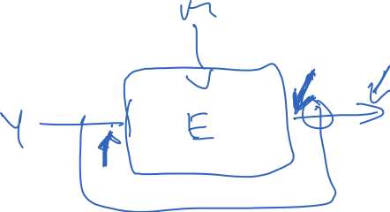
Building compression functions
Want:
Given:

Slide 40
Ideal cipher model
Want:
Given:
Model block cipher as ideal:
Each key selects independent random permutation
BC(k,n) = set of all block ciphers with k bit keys and n bit blocks
All algorithms given oracle access to ideal cipher
Notes:
Examples of broken uses of block cipher. Simple m + z. E(m,z) or E(z,m).

Slide 41
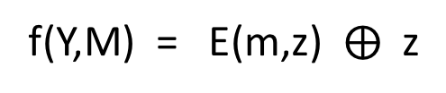

Davies-Meyers compression function
M
64 other “PGV” compression functions
12 have security profile similar to DM
See [Shrimpton, Rogaway 2002]
f(Y,M) = E(m,z) $⨁$ z
Z
E
Notes:
Examples of broken uses of block cipher. Simple m + z. E(m,z) or E(z,m).

Slide 42

From [Rogaway, Shrimpton 2002]

Slide 43
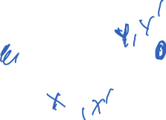
Davies-Meyers compression function
M
64 other “PGV” compression functions
12 have security profile similar to DM
See [Shrimpton, Rogaway 2002]
f(Y,M) = E(m,z) $⨁$ z
Z
E
Notes:
Examples of broken uses of block cipher. Simple m + z. E(m,z) or E(z,m).

Slide 44
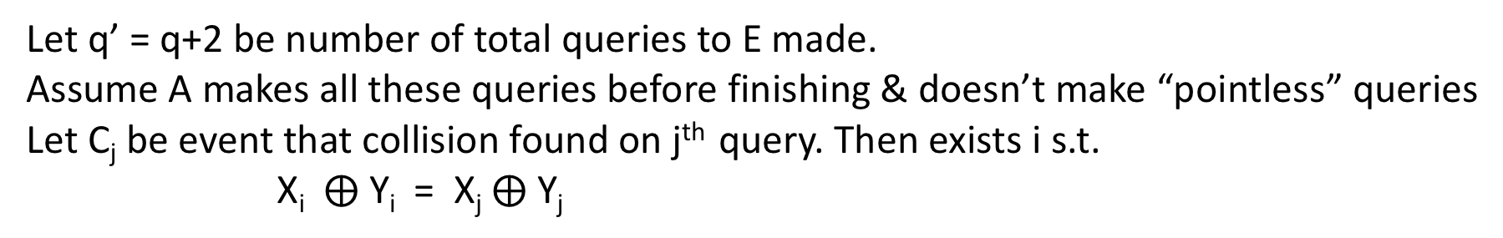
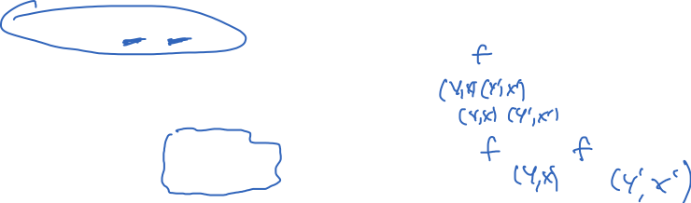
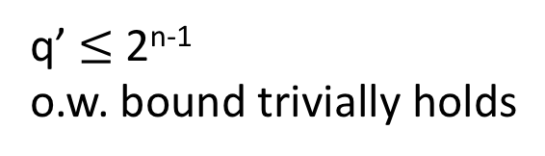
Let q’ = q+2 be number of total queries to E made.
Assume A makes all these queries before finishing & doesn’t make “pointless” queries
Let C_{j} be event that collision found on j^{th} query. Then exists i s.t.
X_{i} $⨁$ Y_{i} = X_{j} $⨁$ Y_{j}
q’ $≤$ 2^{n-1}
o.w. bound trivially holds

Slide 45
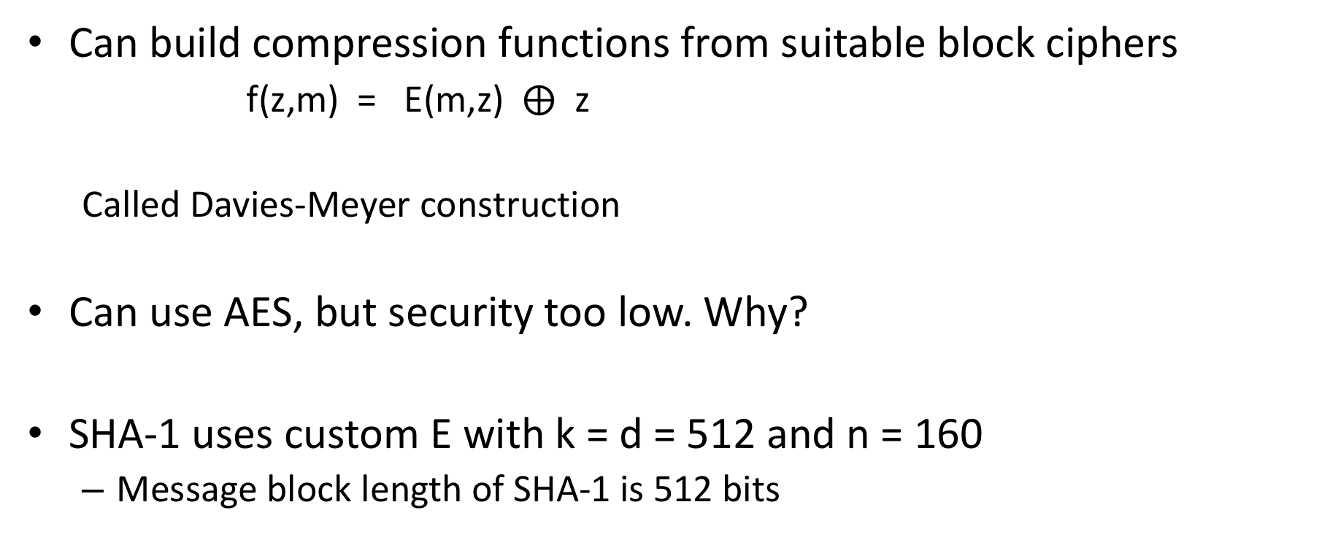
Building compression functions
Can build compression functions from suitable block ciphers
f(z,m) = E(m,z) $⨁$ z
Called Davies-Meyer construction
Can use AES, but security too low. Why?
SHA-1 uses custom E with k = d = 512 and n = 160
Message block length of SHA-1 is 512 bits
Notes:
Examples of broken uses of block cipher. Simple m + z. E(m,z) or E(z,m).

Slide 46
SHA-1 compression function
Expand 512-bit message into
W₁,…,W₈₀ strings of length 32 bit values
(Think of this as “key schedule”)
Chaining variable is 160 bits, 5 32-bit values
A , B , C , D , E
F(B,C,D) function that changes over rounds:
0-19: (B and C) or ((not B) and D)
20-39: B xor C xor D
40-59: (B and C) or (B and C) or (C and D)
60-79: B xor C xor D
Constants K₁ , … , K₈₀ differ across rounds

Slide 47
Cryptanalysis results
2004: Full break of MD5 announced by Xiaoyun Wang and co-authors
MD5 is easy to break now. You can download programs to do it on your laptop
2005: Announced faster than 2⁸⁰ attack against SHA-1 by Wang et al.
Not practical to run (2⁶⁹ estimated cost)
2017: CWI and Google announce first demonstrated collision

Slide 48

SHAttered attack
Chosen prefix P. Find two pairs of message blocks
M₁ , M₂ and M₁’ , M₂’ such that for any suffix S:
SHA-1(P || M₁ || M₂ || S) = SHA-1(P || M₁’ || M₂’ || S)
Referred to as a identical-prefix collision attack
How? Pick P, find M₁ and M₁’ that form near-collision on chaining variable. Then complete collision by finding M₂ and M₂’
They show how to extend to build colliding PDF files

Slide 49
SHAttered attack
Required 2^{63.1} SHA-1 compression function applications
100,000x faster than birthday attack (2⁸⁰)

Slide 50
Fallout of attack
SVN repositories can be broken (DoS attack)
- Checking in the two SHAttered PDFs corrupts repo
Linus Torvalds misunderstands security…
(to paraphrase) GIT’s ok because we can trust everyone
https://plus.google.com/+LinusTorvalds/posts/7tp2gYWQugL
Marc Stevens & Dan Shumow (Microsoft) developed counter-cryptanalysis tool
Way to detect if a particular file is one half of colliding pair
Deployed at several large companies
Ongoing migration away from SHA-1 to SHA-256 / SHA-3

Slide 51
SHA-3 competition
SHA-1 attacks prompted NIST competition for new hash function 2007-2012
51 submissions; 14 proceeded to round 2; 5 finalists
KECCAK selected as winner
Bertoni, Daemon, Peeters, Van Assche

Slide 52

Sponge construction

Slide 53
Towards using hash functions as PRFs
Hash functions don’t have keys. So we must key them somehow to treat as PRFs.
K || M
H
This is vulnerable to length extension attacks

Slide 54
Building PRFs with hash functions: HMAC
Use a hash function H to build a MAC. K is a secret key
ipad != opad are constants
K ipad || M
H
K opad || h
H
T
This is slight simplification, assuming |K| less than block length of H
HMAC-SHA-1, HMAC-SHA-256, etc.

